Slide 1


Spark Interview Questions Akka in Spark

Slide 2
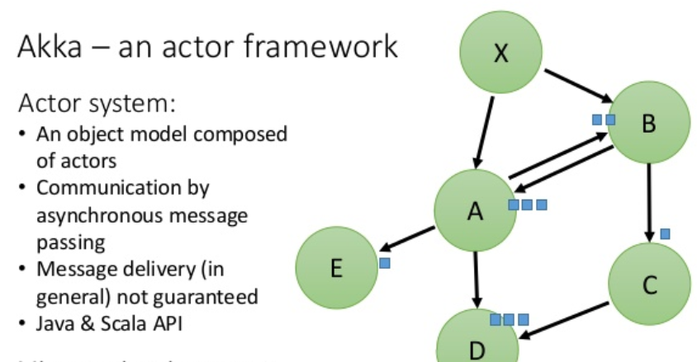
What is AKKA
Akka is a event-driven actor framework to create reactive, distributed, parallel and resilient concurrent applications in Scala or Java.

Slide 3
What is AKKA
Akka uses the Actor model to hide all the thread-related code and gives you really a simple and helpful interfaces to implement a scalable and fault-tolerant system.
Akka decouples business logic from low-level mechanisms such as threads, locks and non-blocking IO.
Akka uses Actor systems that gives you an abstraction layer over threads. These actors are able to communicate with each other by passing anything and everything as messages, and do things parallel and without blocking other code.

Slide 4
Akka in Apache Spark
Spark uses Akka basically for scheduling different parallel task in the spark cluster.
All the workers request for a task to application master after registering.
The master just assigns the task. Here Spark uses Akka for messaging between the workers and application masters.

Slide 5
Thanks and do subscribe to my channel

